Slide 1


Lara Kovalev
04/02/2024

Slide 2

Outline
Executive Summary
Introduction
Methodology
Results
Conclusion
Appendix

Slide 3
Executive Summary
Summary of methodologies
Data Collection from API using Web Scraping
Data Wrangling
Exploratory Data Analysis (EDA) using SQL
EDA through Data Visualization (using Pandas and Matplotlib)
Interactive Visual Analytics through Dashboard built with Folium
Predictive Analysis (Classification with ML)
Summary of all results
EDA results
Interactive analytics captures
Classification results

Slide 4
Introduction
Project background and context: SpaceX advertises Falcon 9 rocket launches on its website with a cost of 62 million dollars; other providers cost upward of 165 million dollars each, much of the savings is because SpaceX can reuse the first stage. Therefore if we can determine if the first stage will land, we can determine the cost of a launch. The goal of this project is to predict if SpaceX will reuse the first stage using a machine learning model trained on public information.
Problems you want to find answers
Will the Falcon 9 first stage land successfully?
On what conditions it depends?

Slide 5

Section 1

Slide 6
Methodology
Executive Summary
Data collection methodology:
The data was collected using web scraping from Wikipedia and SpaceX API.
Perform data wrangling
Usage of One-hot encoding to create categorical features.
Perform exploratory data analysis (EDA) using visualization and SQL
Perform interactive visual analytics using Folium and Plotly Dash
Perform predictive analysis using classification models
How to build, tune, evaluate classification models

Slide 7
Data Collection
The data was collected using web scraping (BeautifulSoup) from Wikipedia and SpaceX API.
Next, the data was turned it into a pandas data frame using pandas function - json_normalize().
Then the missing values in the data were filled in.
The final result is extracted launch records as HTML table, that are parsed into a pandas data frame for future analysis.

Slide 8
Data Collection – SpaceX API
Request (Space X API)
.JSON file and .Json_normalize to get a Pandas DF
Filter only Falcon 9 launches
Complete missing values where necessary with mean
Dictionary relevant data and cast to Data Frame
The get request method was used in SpaceX API to collect data.
GitHub URL:

Slide 9
Data Collection - Scraping
Request Wikipedia
BeautifulSoup
html5lib Parser
Create dictionary
Iterate through table cells to extract data to dictionary
Find launch info html table
Cast dictionary to DataFrame
Applied web scrapping via BeautifulSoup to web scrap Falcon 9 launch records and then converted the scraped data to a pandas DF
GitHub URL:

Slide 10
Data Wrangling
Created a training label using One-hot encoding with landing outcomes.
Outcome column has two components: “Mission Outcome” “Landing Location”
New training label column ‘class’ with a value of 1 if ‘Mission Outcome’ is True and 0 otherwise considering the Mission Outcome and Landing Location.
GitHub URL:

Slide 11
EDA with Data Visualization
Exploratory Data Analysis was conducted on various variables including Flight Number, Payload Mass, Launch Site, Orbit, Class, and Year. The analysis involved visualizing relationships such as flight number and launch site, payload and launch site, success rate for each orbit type, flight number and orbit type, as well as examining the launch success trend on a yearly basis.
GitHub URL:
photo

Slide 12
EDA with SQL
EDA using SQL for in-depth understanding of the space mission dataset.
Data Preparation: Loaded dataset into IBM DB2 Database.
SQL Queries for Exploration: Utilized SQL Python integration.
Key Queries:
Launch Sites
Payload Mass (NASA - CRS)
Average Payload Mass (Booster Version F9 v1.1)
Mission Outcomes (Successful and Failed)
Failed Landings on Drone Ship (Booster Versions and Launch Site Names)
Final Stage: Comprehensive exploration of launch sites, payload masses, booster versions, and mission outcomes.
GitHub URL:

Slide 13
Build an Interactive Map with Folium
By utilizing Folium maps, it was possible to visually identify Launch Sites, as well as successful and unsuccessful landings. Additionally, it provided a proximity illustration to key locations such as Railway, Highway, Coast, and City.
This visualization aids in comprehending the rationale behind the placement of launch sites and offers insights into the spatial distribution of successful landings in relation to their geographical locations.
GitHub URL:

Slide 14
Build a Dashboard with Plotly Dash
Dashboard Components:
Incorporates a visually appealing pie chart and a dynamic scatter plot.
Pie Chart Functionality:
Allows users to toggle between two views:
Displaying the distribution of successful landings across all launch sites.
Showing individual launch site success rates.
Scatter Plot Features:
Employs a versatile scatter plot with customizable inputs:
Choose between analyzing all launch sites or focus on an individual site.
Utilize a payload mass slider ranging from 0 to 10000 kg.
Visualization Purpose:
The pie chart serves to visually represent launch site success rates.
The scatter plot serves for visual exploration of success variations across launch sites, payload mass, and booster version categories.
GitHub URL:

Slide 15
Predictive Analysis (Classification)
Loded and preprocessed the data with NumPy and Pandas, performed data transformation, splited it into training and testing sets, constructed various machine learning models with hyperparameter tuning using GridSearchCV, assessed model performance using accuracy as a metric, enhanced the model through feature engineering and algorithm tuning, ultimately identifying the best-performing classification model.
GitHub URL:
Split label column ‘Class’ from dataset
Transform Features using StandardScaler
Finding of optimal parameters using GridSearchCV on LogReg, SVM, Decision Tree, andKNN models
Score each model using test set accuracy and Confusion Matrix of all models
Train + Test split of the data
Bar plot to compare scores of all models

Slide 16
Results
Exploratory data analysis results
Interactive analytics demo in screenshots
Predictive analysis results

Slide 17

Section 2

Slide 18

Flight Number vs. Launch Site
The data indicates a positive correlation between the flight amount at a launch site and its success rate, with a noticeable breakthrough around flight 20 contributing to a significant increase in success rate. The graphic further emphasizes CCAFS as the primary launch site, displaying the highest volume over time.
Blue indicates successful launch; Orange indicates unsuccessful launch.

Slide 19

Payload vs. Launch Site
The payload mass typically falls within the range of 0-6000 kg.
There is a correlation observed where the success rate of rockets at the CCAFS SLC 40 launch site increases with greater payload mass.
Blue indicates successful launch; Orange indicates unsuccessful launch.

Slide 20
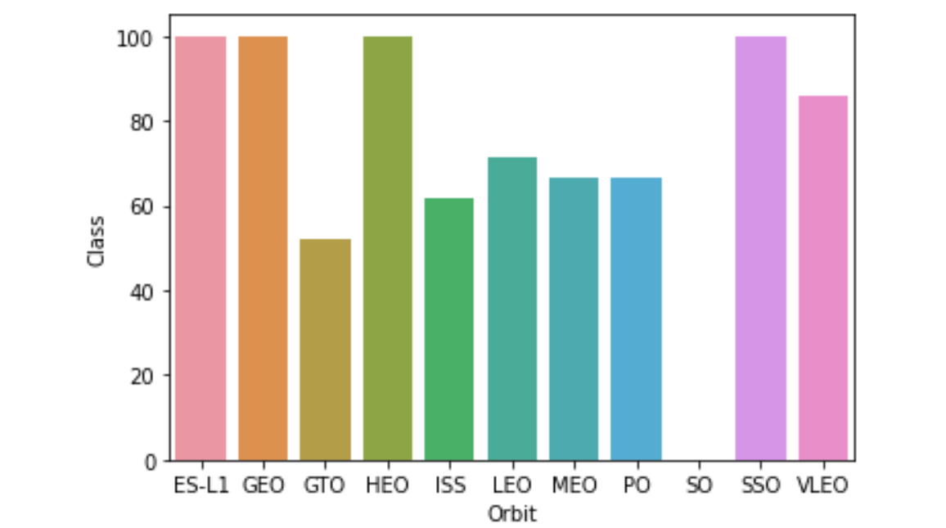
Success Rate vs. Orbit Type
ES-L1, GEO, HEO, SSO have 100% success rate (the most success rate)
SO has 0% success rate
Mapping
1 is 100%
0 is 0%

Slide 21

Flight Number vs. Orbit Type
The presented plot illustrates the relationship between Flight Number and Orbit type. In the LEO orbit, success appears to be correlated with the number of flights, while in the GTO orbit, there is no discernible connection between flight number and the orbit.
Blue indicates successful launch; Orange indicates unsuccessful launch.

Slide 22

Payload vs. Orbit Type
Notably, when dealing with heavy payloads, there is a higher frequency of successful landings observed in the PO, LEO, and ISS orbits.
Blue indicates successful launch; Orange indicates unsuccessful launch.

Slide 23
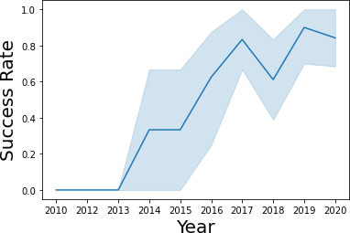
Launch Success Yearly Trend
The plot indicates a continuous increase in the success rate from 2013 to 2020.

Slide 24
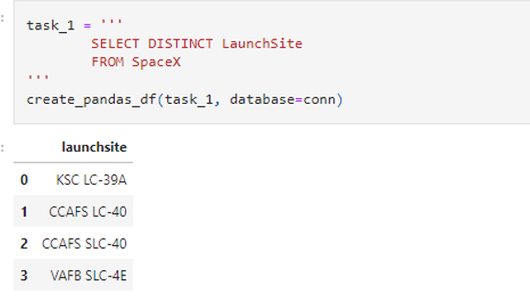
All Launch Site Names
Used the key word DISTINCT to show only unique launch sites from the SpaceX data.

Slide 25
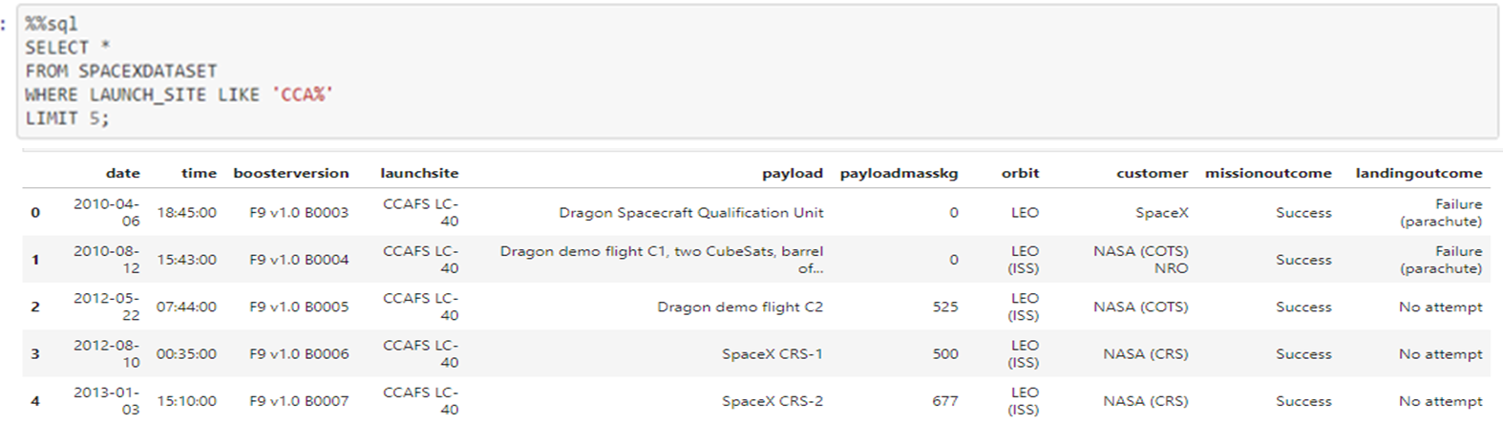
Launch Site Names Begin with 'CCA'
Found records that contain CCA using the LIKE key word
Found only 5 results using LIMIT 5

Slide 26
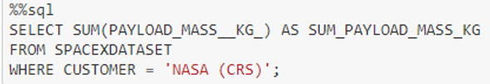
Total Payload Mass
This query sums the total payload mass as 45596 in kg where NASA was the customer:

Slide 27
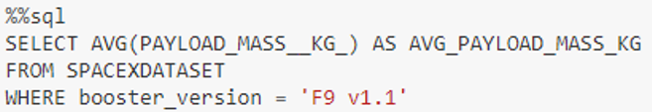
Average Payload Mass by F9 v1.1
This query calculates the average payload mass or launches which used booster version F9 v1.1
the average payload mass carried by booster version F9 v1.1 is 2928.4

Slide 28
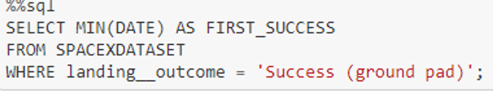
First Successful Ground Landing Date
This query returns the first successful ground pad landing date.

Slide 29
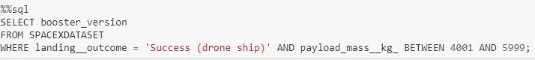
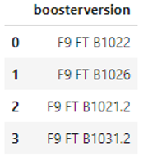
Successful Drone Ship Landing with Payload between 4000 and 6000
Applied the WHERE clause to filter for boosters that successfully landed on a drone ship and employed the AND condition to identify successful landings with a payload mass ranging from greater than 4000 to less than 6000.

Slide 30
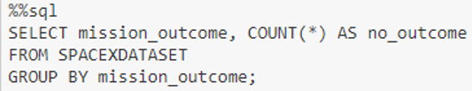
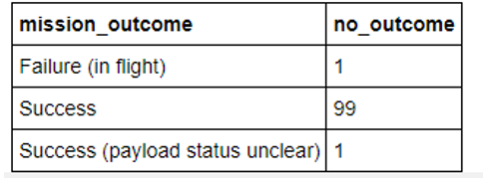
Total Number of Successful and Failure Mission Outcomes
Utilized wildcard '%' to filter for cases where MissionOutcome was either a success or a failure in the WHERE clause.

Slide 31
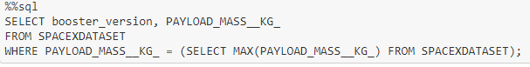
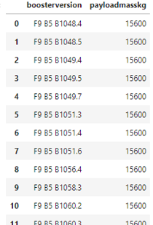
Boosters Carried Maximum Payload
In the WHERE clause, we identified the booster that carried the maximum payload by employing a subquery in conjunction with the MAX() function.

Slide 32
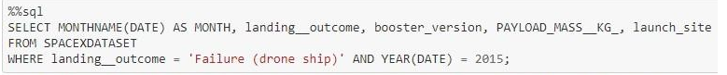
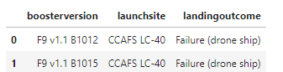
2015 Launch Records
Used a combination of the WHERE clause, LIKE, AND, and BETWEEN conditions to filter for failed landing outcomes on a drone ship, including their associated booster versions and launch site names specifically for the year 2015.

Slide 33
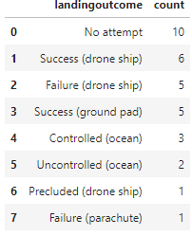
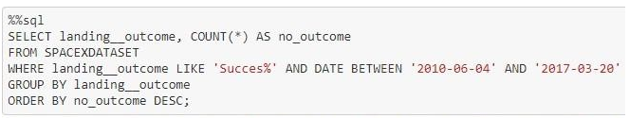
Rank Landing Outcomes Between 2010-06-04 and 2017-03-20
Selected Landing outcomes and the COUNT of landing outcomes from the data, using the WHERE clause to filter for outcomes between 2010-06-04 to 2010-03-20.
Applied the GROUP BY clause to group the landing outcomes and utilized the ORDER BY clause to arrange the grouped landing outcomes in descending order.

Slide 34

Section 3

Slide 35

Launch Site Locations
The map shows all launch sites.
All the lunch sites are located on the coast line of US.

Slide 36

Markers of launch sites with color labels
The map shows lunch sites that are separated into 2 groups:
Green: successful lunch
Red: failure

Slide 37



Launch sites and their proximities
We can see launch sites are close to and highways for human and supply transport.
Launch sites are strategically positioned in proximity to coasts and at a considerable distance from cities to ensure that launch failures can safely land in the sea, thereby mitigating the risk of rockets falling in densely populated areas.

Slide 38

Section 4

Slide 39
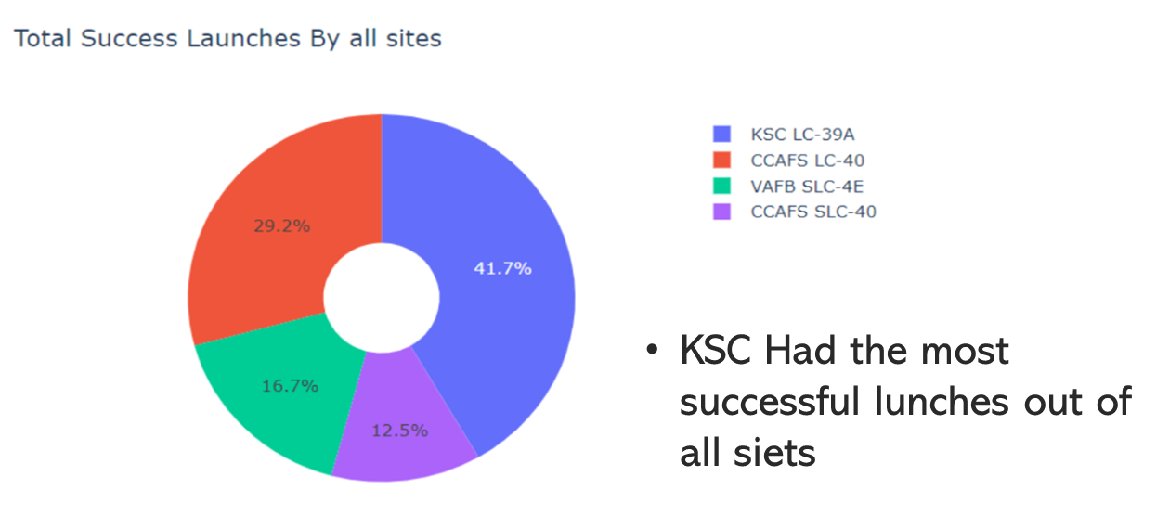
Pie chart: Total Success Launches by All Sites

Slide 40

Highest Success Rate Launch Site
KSC LC-39A has the highest success rate .

Slide 41

Payload Mass vs. Success vs. Booster Version Category
Success rates for low weighted payloads is higher than heavy payloads

Slide 42

Section 5

Slide 43

Classification Accuracy
The decision tree classifier is the model with the highest classification accuracy

Slide 44

Confusion Matrix
The confusion matrix of the decision tree classifier indicates its ability to differentiate between various classes, with the primary challenge lying in false positives—instances where the classifier incorrectly labels unsuccessful landings as successful ones.
Correct predictions are on a diagonal from top left to bottom right.
All models showed consistent performance on the test set, sharing identical confusion matrices. They predicted 12 successful landings accurately but incorrectly predicted 3 unsuccessful landings as successful (false positives), indicating an overprediction tendency for successful landings.

Slide 45
Conclusions
There is an increase in launch success rate from 2013 to 2020.
Orbits ES-L1, GEO, HEO, SSO, and VLEO exhibited the highest success rates.
KSC LC-39A had the most successful launches among all sites.
The Decision tree classifier emerged as the best machine learning algorithm for this task.
Achieved a machine learning model with an accuracy of 83%.

Slide 46


